Slide 1
Welcome to Week-2
Advanced Programming in Python
By Engr. Imran Khan
Instructor

Slide 2
Previous Week
Python Uses and Applications
Environment Jupyter
Two Modes
Ipython
Python scripts
Variables and types
Type Casting
Arithmetic operations
Comparison operators
Logical operators
Strings

Slide 3
Motivational Lecture
https://www.youtube.com/watch?v=niNk9-ibLcY
Notes:
- showcase power of Python
- you're not expected to understand all of it

Slide 4

Introduction to
Notes:
Had a nice break and enjoyed yourselves so far.
moving to more complicated datatypes and concepts in programming.
Let us begin with higher level structures/containers
CC-BY Digital Skills Team at the University of Edinburgh www.ed.ac.uk/is/skills

Slide 5
This Week
Institute/Work ethics
Examples and some standard rules
More on Data Types
Functions (built-in functions/ create functions) and Python Arrays
Loops
Decisions
Python Dates and Times
Reading and Writing CSV
Lambda and List Comprehensions
Advance Python Objects, map()
Python Types and Sequences
Numerical Python Library (Numpy)
Data Science

Slide 6
Workplace/Institute Ethics
Work ethic is a standard of conduct and values for job performance.
Different businesses have different expectations.
Set of values centered on importance of work
Attendance
Character
Team Work
Appearance
Attitude
Productivity
Organizational Skills
Communication
Cooperation
Respect

Slide 7
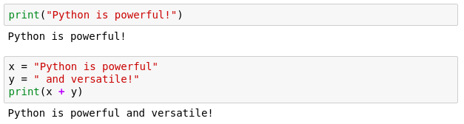
Printing
When writing scripts, your outcomes aren't printed on the terminal.
Thus, you must print them yourself with the print() function.
Beware to not mix up the different type of variables!

Slide 8

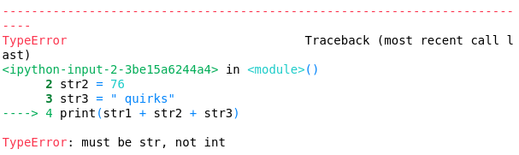
Quick quiz
Do you see anything wrong with this block?
Notes:
Let's see if everybody remembers their types
Is there anything wrong with this block or will it execute nicely?
[issue] Any idea how we can fix it?

Slide 9
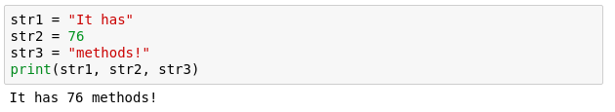
Another more generic way to fix it
If we comma separate statements in a print function we can have different variables printing!

Slide 10
Reserved Words:
Keywords contain lowercase letters only.
and | exec | not
assert | finally | or
break | for | pass
class | from | print
continue | global | raise
def | if | return
del | import | try
elif | in | while
else | is | with
except | lambda | yield

Slide 11
Commenting
Useful when your code needs further explanation. Either for your future self and anybody else.
Useful when you want to remove the code from execution but not permanently
Comments in Python are done with #
Notes:
You seen the # symbols in the slides.
I forget what I write; need to remind my future self
Programmers though it's better to write explanation in between the code
Show example

Slide 12

If Else
Fundamental building block of software
Conditional statement
Executed if answer is True
Executed if answer is False
Notes:
ask very politely "Do you really want to close me", answers Yes and No that is essentially a if-else block.
press Yes the program closes else, you press no and the program continues.
All programs build on if-else blocks, a lot of if-else blocks
The expression in the brackets after the if is the boolean evaluation expression.
If True, execute the code between if and else, if False execute code after else.

Slide 13
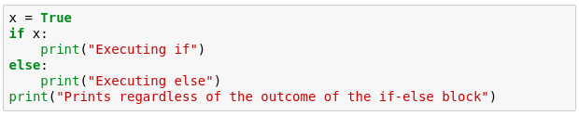
If Else example
Try running the example below.
What do you get?
Notes:
Here is an example that is also included in your notebooks
Go through the example
noticed that the first 2 print statements don't have the same indentation level

Slide 14
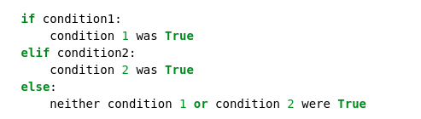
Extending if-else blocks
We can add infinitely more if statements using elif
elif = else + if which means that the previous statements must be false for the current one to evaluate to true
Notes:
extend if block to many different conditions.
done with the elif
previous statements have been false and the current condition is true then execute the current elif block.
Relevant bitcoin example in your code.

Slide 15

For loop
Allows us to iterate over a set amount of variables within a data structure. During that we can manipulate each item however we want
Again, indentation is important here!
Notes:
lists and others are useful when loops
Loops allow us to iterate over containers
For loops are the more controllable
Code explanation
Item is a subset of itemList

Slide 16
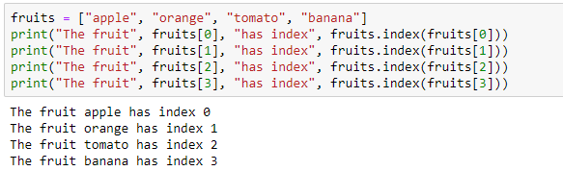
Example
Say we want to go over a list and print each item along with its index
What if we have much more than 4 items in the list, say, 1000?
Notes:
We have 4 copy pasted lines
What if we have more items?
Can we use for?

Slide 17
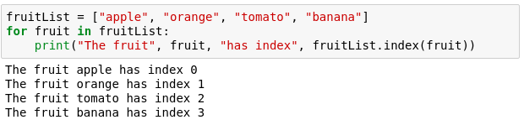
For example
Now with a for loop
Saves us writing more lines
Doesn't limit us in term of size
Notes:
Saves us a few lines of writing
Allows us to not care about size of the list

Slide 18
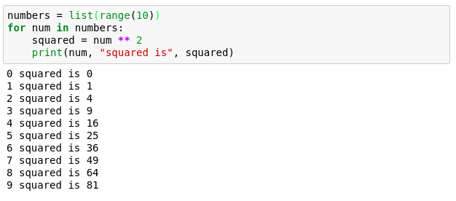
Numerical for loop
Notes:
more useful usage of the for loop.
iterate over 0 to 9 and find the squares

Slide 19
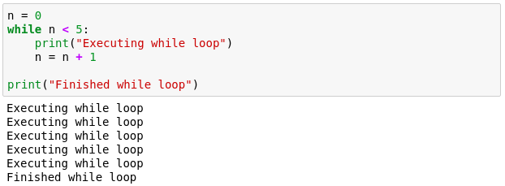
While loop
Another useful loop. Similar to the for loop.
A while loop doesn't run for a predefined number of iterations, like a for loop. Instead, it stops as soon as a given condition becomes true/false.
Notes:
While less controllable than for
Manual control inside.
We must tell it when to stop
While loop that executes 5 times

Slide 20
I HOPE YOU LEARN A LOT & ENJOY THE Today TRAINING! THANK YOU ☺

